Slide 1
2019
Leading Produce Categories
Leading Produce Categories – Insights for Growth
Identifying growth opportunities for Hass Avocados with insights from the top ten produce categories

Slide 2
Table of Contents
Objective and Executive Summary | 3
Terms and Definitions | 6
Key Insights | 8
Key Actions and Opportunities | 9
Shopper: Category Purchase Trends | 10
Retailer: Category Trips and Market Basket | 17
Data Source Information | 28

Slide 3
Objective and Executive Summary
Objective
The objective of this study is to identify the relevant purchase dynamics underlying the retail performance of the largest categories in fresh produce to understand how these dynamics differ for the avocado category. Additionally, this study aims to identify the implications of these differences with respect to avocado category growth.
Executive Summary
Retailer competition for consumers’ grocery dollars continues to intensify with acquisitions, new store formats, channel blurring, new technologies, and the growth of consumer spending in food away from home. Amid this constant change, perimeter categories such as fresh produce remain a primary determinant of shoppers’ choice of preferred retailer. For this reason, maintaining a well-stocked, high-quality selection of the fruits and vegetables that shoppers purchase most often is a key competitive requirement.
Based on 2018 household purchases* ($), the top ten fruit and vegetable categories at the top of shoppers’ lists in descending order are:
Continued next page…
7. | Grapes ($2.2B)
8. | Bagged Salads ($1.9B)
9. | Avocados ($1.6B)
10. | Melons ($1.2B)
1. | Berries ($5.1B)
2. | Apples ($3.4B)
3. | Bananas ($2.8B)
4. | Lettuce ($2.7B)
5. | Tomatoes ($2.7B)
6. | Potatoes ($2.6B)
*Household purchasing data complements retail sales data. Households purchases are projected using a representative panel of Total U.S. households. For more information on purchase data, see slide 28

Slide 4
Executive Summary Cont.
The shoppers that purchase these large produce categories are highly valued by the retailer, and retailers in turn provide these categories with more shelf space. Households that at any time purchase one of the top five categories in the top ten account for a larger proportion of overall trips to the retailer. In 2018, retailers registered more than 18 billion total retail trips, and each individual category in the top five accounted for more than 80% of total retail trips. Avocados rank number nine among the top ten largest produce categories, but avocado shoppers accounted for a smaller proportion of total retail trips (54%).
While pricing, promotion, supply levels and numerous other factors influence shopper purchases, the size of any category is largely driven by the proportion of category retail trips that include a purchase of that particular category. This “Trip Incidence” is higher for the top six produce categories and is largely a factor of household penetration and purchase frequency. For example: The study found that Bananas have the top Trip Incidence rate, with nearly 9% of Banana shopper retail trips including a purchase of Bananas. Bananas also have one of the highest penetration rates (87%) and have the highest purchase frequency (15 trips per year). In comparison, Avocados have a Trip Incidence rate nearing 5%, penetration of 53%, and a purchase frequency of 7 trips per year.
Continued next page…

Slide 5
Executive Summary Cont.
These larger categories also deliver a greater In-Basket and Rest-of-Basket Premium to the retailer. For example, when Lettuce is in the basket, the basket ring is +81% higher than when Lettuce is not in the basket. For Avocados, the In-Basket Premium is +67%. The Rest-of-Basket Premium is also greater for larger categories. When shoppers purchase Lettuce, the value of all other items in the basket increases +75%. For a smaller category like Melons, the value of all other items increases +57%.
This reinforces the value of these larger categories to the retailer and likely influences the retailer’s merchandising approach. Retailers may give more space and merchandising attention to a category that brings more value to the retailer, which in turn can drive more retail trips for that particular category. This creates a “self-reinforcing” dynamic. Prominent merchandising can increase the likelihood shoppers will make more trips to purchase the category, resulting in a larger category.
The insights and opportunities in this study can help boost the Avocado category up in the top ten produce category ranking. Marketers and retailers can leverage these insights to build their own merchandising and marketing strategies to grow sales of Hass Avocados in the marketplace.

Slide 6
Terms and Definitions
Source Data:
IRI Consumer NetworkTM 2018 (Details on page 28)
Fusion Marketing: Study development
Time Periods:
Current Year (CY) – 2018 Calendar year
Prior Year (PY) – 2017 Calendar year
Metrics: All figures in this report are rounded
Household Penetration – Percentage of total U.S. households that purchase the category
Repeat Buyer Rate – Percentage of category shoppers that purchase the category more than once per year
Buyer Rate (Annual Spend per Category-Buying Household) – Average annual spend on the category per category-buying household. Annual Spend = Number of Trips X Spend per Trip
Number of Trips – Average annual category purchase occasions per category-buying household
Spend per Trip – Average category dollar spend per purchase occasion
Purchases – Throughout this report, “Purchases” refers to dollar purchases. Volume/units/eaches are not available
Total Retail Trips – Number of retail purchase trips by U.S. households (for any categories) in the following retail channels: Grocery, Mass/Supercenter, Walmart, Club, Dollar, Internet, Drug, Military, Misc.
Category Retail Trips – Number of retail purchase trips by U.S. households that purchase a specific category in the following retail channels: Grocery, Mass/Supercenter, Walmart, Club, Dollar, Internet, Drug, Military, Misc.
Category Trip Incidence: Category Shoppers – Percentage of category trips in the above channels that include the category
Market Basket Value – Average dollar ring per shopping trip. Calculated with and without the category
In-Basket Premium – Incremental value of the Market Basket when the target category is in the basket
Rest-of-Basket Value – Average value of the other (non-category) items in the basket when the category is in the basket
Rest-of-Basket Premium – Incremental value of other items in the basket when the target category is in the basket

Slide 7
Larger categories create a self-reinforcing dynamic of importance to the retailer
Higher penetration drives more retail trips, and retail trips are the driving factor behind category size
Higher Penetration
More Retail Trips
As a category becomes larger, the self-reinforcing dynamic strengthens
More Category Purchase Occasions
Increased Item Space and Merchandising
Larger and More Important Category to The Retailer
More Item Trips
Boosts Market Basket Value

Slide 8
Key Insights
Key Insight: P. 11
Avocados rank among the top ten fresh produce categories. As a top-tier category, Avocados warrant top-tier merchandising by retailers in order to meet shopper needs and preferences.
Key Insight: P. 12, 19
Household penetration is a key driver of category size among the top ten fresh produce categories. The top six largest produce categories are purchased by approximately 80% or more of total U.S. households.
Key Insight: P. 13
Households that purchase the larger categories also have higher repeat purchase rates, indicating these categories seem to function more as “staples”. Categories with lower repeat rates may function more as special occasion or seasonal purchases for some.
Key Insight: P. 15, 16
The larger produce categories are purchased more often than smaller categories, indicating that purchase occasions influence category size. In contrast, spend per trip is influenced by the category’s pricing dynamics, and is not clearly correlated with category size.
Key Insight: P. 24
The In-Basket Premium is greater for the larger categories, with the exception of Bananas. This reinforces the value of these larger categories to the retailer.

Slide 9
Key Actions and Opportunities
Key Opportunity
Increase Avocado Shopper Trips to the Retailer
While category growth can come from gains in trip frequency and spend per trip, increasing Household penetration offers greater strategic leverage. Higher penetration translates to higher trip incidence, increasing the value of the category to the retailer.
Key Opportunity
Reinforce the Value of Avocado Shoppers to the Retailer
Avocado shoppers are valuable to the retailer. Avocado purchases also drive an increase in purchases of other items in the store. When Avocados are in the basket, the value of all other items in the basket increases +57%. This can serve as a strong incentive for retailers to more aggressively merchandise and promote the category.
Key Opportunity
Reinforce the Value of the Avocado Category to the Retailer
The avocado category is one of the fastest growing categories in the top ten and is a growth-leader across many metrics. Avocados posted the highest increases in:
Penetration • Repeat Purchase Rate
Under merchandising a high-growth, large category like Avocados may inhibit its full potential to the retailer. Prominent merchandising at shelf can increase the likelihood shoppers will make more trips to purchase the category, and in turn drive category value to the retailer.
Purchase Occasions • Total Retail Trips

Slide 10
SHOPPER: category Purchase trends
Leading Produce Categories – Insights for Growth

Slide 11
Avocados are one of the largest categories in fresh produce, ranking among the top ten categories in purchase dollars
Avocados rank #9 in purchase dollars compared to other top ten produce categories.
Avocado purchases grew +3.5% vs. prior year, which was the second highest growth rate among the top ten categories. Four out of the top ten categories posted growth.
*Household purchasing data complements retail sales data. Households purchases are projected using a representative panel of Total U.S. households. For more information on purchase data, see slide 28
Data Source: IRI Consumer NetworkTM 2018 vs. 2017.

Slide 12
The top six produce categories are purchased by approximately 80% of U.S. households
Six of the top ten categories have household penetration rates approaching or exceeding 80% of U.S. households, ranging from 79.9% for Apples to 87.9% for Potatoes.
Avocados have the lowest penetration in the lineup at 53.4%, behind Bagged Salads (57.9%) and Melons (60.2%).
The Avocado category is one of the two categories that grew penetration in 2018, increasing +1.8 percentage points. Bagged Salad penetration rose +0.9 percentage points.
Data Source: IRI Consumer NetworkTM 2018 vs. 2017

Slide 13
The top six categories also have higher repeat purchase rates
The top six categories also have the highest repeat rates, ranging from 82.8% for Apples to 91.7% for Bananas.
While Avocados have the lowest penetration among the top ten (P.12), most avocado shoppers are likely to purchase Avocados more than once per year (77.8%).
Avocados are the only category in the list to show an increase in repeat rate. Avocado shopper repeat rate increased +2.5 percentage points vs. prior year.
Data Source: IRI Consumer NetworkTM 2018 vs. 2017

Slide 14
Annual category spend per household is weakly correlated with category size, but is a factor in category size
Berries and Apples have the two highest Annual Spend rates, but Annual Spend varies among the top ten.
Avocado spend per household is $24.09 but declined slightly vs. 2017 (-0.8%).
Melons is the smallest of the top ten produce categories and also has the lowest Annual Spend per household among the group at $15.50.
Data Source: IRI Consumer NetworkTM 2018 vs. 2017

Slide 15
Purchase frequency influences category size, and an increase in frequency can result in more retail trips
Purchase frequency tends to be higher for larger categories in the lineup, with the top five showing more than 7 purchase occasions in 2018.
The avocado category showed a relatively high purchase frequency at 6.9 trips. The category also showed the highest increase in purchase frequency, up +12.3% vs. prior year.
Grapes, Bagged Salads and Melons showed purchase frequencies below 6.
Data Source: IRI Consumer NetworkTM 2018 vs. 2017

Slide 16
Spend per trip is influenced by a category’s pricing dynamics, and is not clearly correlated with category size
Spend per trip reflects not only how much shoppers buy at each purchase occasion, but also other factors such as pricing dynamics and supply factors.
Berries, which are one of the higher-priced produce categories, have the top spend per trip at $5.11. In contrast, Bananas, which tend to be a lower-priced produce category, show the lowest spend per trip at $1.72.
Avocado spend per trip declined -11.6% in 2018 to $3.48 per trip.
Data Source: IRI Consumer NetworkTM 2018 vs. 2017

Slide 17
RETAILER: category TRIPS & Market Basket
Leading Produce Categories – Growth Insights

Slide 18
Total U.S. households made more than 18 billion trips to retailers in 2018. Households that purchase avocados made 10 billion trips, but did not make an avocado purchase during each trip
Total 2018 Retail Trips = 18.4 Billion
U.S. households made 18.4 billion trips to retailers in 2018. Households that purchase Berries accounted for 15.3 billion retail trips, while households that purchase Avocados accounted for 10.0 billion retail trips* (a household that purchases Berries can also purchase Avocados).
Households that purchase Avocados show the greatest increase in retail trips, up +5.8% vs. prior year.
*Retail trips for any item purchase, not just category purchases
Data Source: IRI Consumer NetworkTM 2018 vs. 2017

Slide 19
The 10 billion avocado shopper trips accounted for 54% of total 2018 retail trips
Total 2018 Retail Trips = 18.4 Billion
Households who at any time purchase one of the larger categories account for a greater proportion of overall retail trips. For each of the top six produce categories, this proportion exceeds 80%. This in turn gives retailers more sales opportunities in those categories.
Households that purchase Avocados account for 54% of retail trips but showed the greatest proportion increase (+2.2 points) of any top ten category.
Data Source: IRI Consumer NetworkTM 2018 vs. 2017

Slide 20
Avocado shoppers purchased avocados during 4.6% of their 10 billion retail trips
Total 2018 Avocado Shopper Retail Trips = 10.0 Billion
Trip Incidence* tends to be higher for the larger categories than for the smaller categories in the top ten. Bananas have the top Trip Incidence rate, at 9.9%, with Melons at 2.6%.
The Trip Incidence rate for Avocados is 4.6%, with 458.2M of the 10.0B avocado shopper retail trips including a purchase of Avocados.
Avocados showed the greatest increase in Trip Incidence, up +0.4 points vs. prior year.
*Trip Incidence = The proportion of category retail trips that include a purchase of the category. Example: Bananas were purchased during 9.9% of Banana shopper retail trips
Data Source: IRI Consumer NetworkTM 2018 vs. 2017

Slide 21
In-Basket value varies among the top ten categories. In-Basket value is highest for Potatoes and Bagged Salads
Among the top ten categories, Market Basket value is not correlated with category size.
Potatoes and Bagged Salads have the top In-Basket value in the lineup. Bananas have the lowest In-Basket value.
Avocados rank 8th in In-Basket value at $69.72, a small decline vs. prior year (-1.5%).
Data Source: IRI Consumer NetworkTM 2018 vs. 2017

Slide 22
When the category is not included in the basket, the basket value is lower for all of the top ten produce categories
Market Basket value is lower when the category is not in the basket for all top-ten produce categories.
The next slide shows the difference between the value of the Market Basket when a category is included in the basket and when it is not included in the basket – i.e. the In-Basket Premium.
Data Source: IRI Consumer NetworkTM 2018 vs. 2017

Slide 23
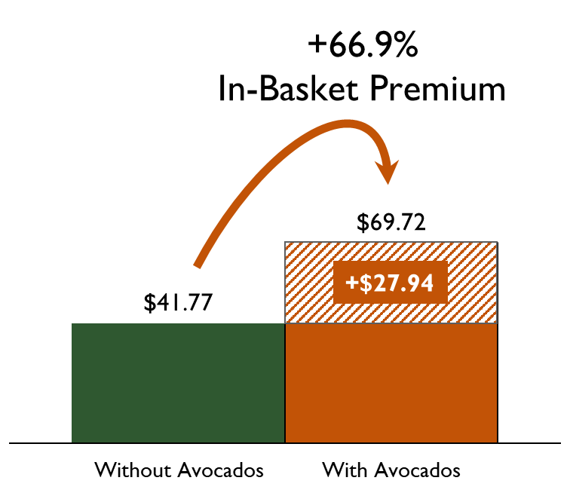
Avocados show an In-Basket Premium* of +66.9% (+$27.94)
In-Basket Premium of Avocado Category
The value of the Market Basket when Avocados are included in the basket is $69.72. When Avocados are not included in the basket, the value is $41.77.
When Avocados are included in the basket, Market Basket value increases +66.9% or +$27.94.
*Value of market basket when Avocados are in the basket vs. when Avocados are not in the basket

Slide 24
The In-Basket Premium is in the high double-digits for all top ten produce categories
Basket
$ Gain
Seven out of ten categories show an In-Basket premium above 70%. The In-Basket Premium ranges from +62.9% for Bananas to +89.8% for Potatoes.
In-Basket Premium declined for the majority of categories in the top ten. Berries and Lettuce increased slightly.
Data Source: IRI Consumer NetworkTM 2018 vs. 2017

Slide 25
Rest-of-Basket measures the value of the other, non-category items in the basket when the category is in the basket
When the category is in the basket, the value of the other, non-category items is higher. In other words, when shoppers purchase the category, they also spend more on other, non-category items.
The next slide shows the difference between the value of other items in the basket when a category is included in the basket and when it is not included in the basket – i.e. the Rest-of-Basket Premium.
Data Source: IRI Consumer NetworkTM 2018 vs. 2017

Slide 26
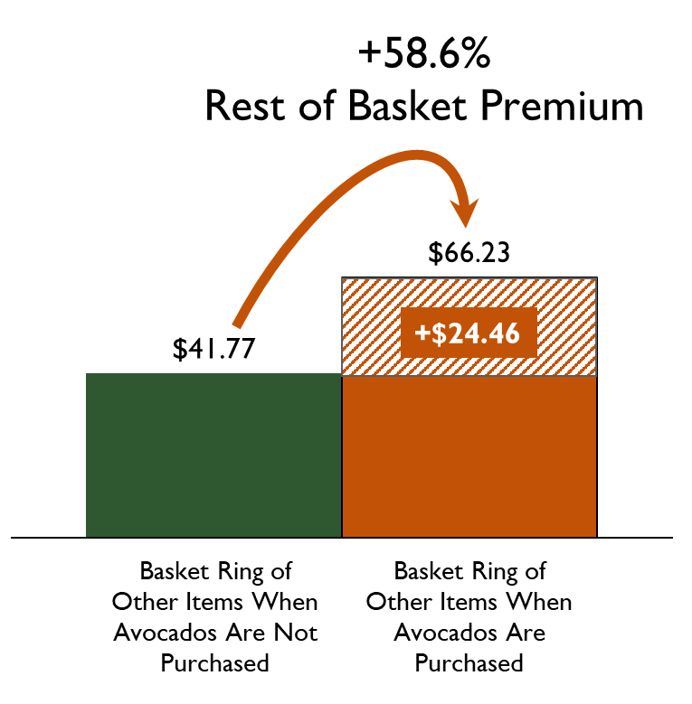
Avocados show a Rest-of-Basket Premium* of +58.6% (+$24.46)
Rest-of-Basket Premium of Avocado Category
The Rest-of-Basket Value when Avocados are included in the basket is $66.23. When Avocados are not included in the basket, the value is $41.77.
When Avocados are included in the basket, the market basket value of all other items increases +58.6%.
*Comparison of the value of other items in the market basket when Avocados are in the basket ($66.23) vs. when Avocados are not in the basket ($41.77)

Slide 27
The Rest-of-Basket Premium is also in the high double-digits for all top ten produce categories
Basket
$ Gain
All top ten produce categories show a Rest-of-Basket Premium in excess of +50%.
Rest-of-Basket Premium increased slightly for Berries, Apples, Lettuce and Tomatoes, but declined for the other top ten categories.
Data Source: IRI Consumer NetworkTM 2018 vs. 2017

Slide 28
Data Source: IRI Consumer NetworkTM
This report is based on household purchasing data from the IRI Consumer NetworkTM. IRI receives its household purchasing data from the National Consumer Panel (NCP), an operational joint venture by IRI and Nielsen. The NCP is a continuous household purchasing consumer panel that consists of a representative sample of U.S. households who electronically record all purchases. Households are recruited to the NCP and are incented to record all of their purchases, regardless of where purchased, using a handheld in-home scanning device.
Household purchasing data complements retail sales data and provides a deeper understanding of category dynamics by focusing on shoppers and their purchase behaviors. In turn, understanding shopper purchase behaviors helps uncover opportunities for growth and aids in effective sales and marketing decisions.
In-store purchases
Electronically recorded at home

Slide 29
Thank you
For additional retail information and insights please visit the Hass Avocado Board website at:
hassavocadoboard.com

