Slide 1
2019
Millennial
Study Part 2
Millennial Avocado Market Basket
Growth opportunities for Hass avocados
with insights into the Millennial avocado market basket

Slide 2
Objective and Executive Summary
Objective
The objective of this study is to identify growth opportunities for Hass avocados by understanding the purchase habits of Millennial avocado-purchasing households and the role they are playing in the growth of the category. Additionally, this study will reveal insights on the value and content of the Millennial market basket with and without avocados compared to the Non-Millennial market basket.
Executive Summary
Millennial shoppers are quickly becoming a driving force in the retail marketplace, and retailers and merchandisers are taking notice. As Millennials enter the next stage of their lives, they’re starting families and expanding their purchasing power. As Millennial purchasing power grows, so does their appetite for fresh produce, specifically avocados.
Part 1 of the Millennial Study revealed that Millennial households are a high-value segment of the avocado category, as they were more likely to purchase avocados and spend more per household on avocados than Non-Millennial households. Part 2 of the study shows that Millennial households are especially valuable to avocado merchandisers and retailers.
Continued next page…

Slide 3
Executive Summary – Cont.
Among avocado-purchasing households, Millennial market baskets were more likely to include avocados than Non-Millennial baskets, but Non-Millennials purchased avocados during a greater number of total trips. In 2018, avocado-purchasing Millennials made 2.1 billion total trips to the retailer and purchased avocados during 6% of those trips for a total of 124 million avocado purchase occasions. In contrast, Non-Millennials made 7.9 billion total trips to the retailer and purchased avocados during 4% of those trips for a total of 334 million avocado purchase occasions.
Additionally, Millennial avocado purchase trips were more valuable to the retailer than Non-Millennial avocado purchase trips: When avocados were in the basket, the value of the Millennial market basket was $77.28, which was +16% higher than the Non-Millennial market basket. This was due to greater Millennial spend on avocados and other items in the basket.
Millennial households also generated a greater In-Basket Premium for the retailer. The Millennial average market basket value of $77.28 with avocados and $46.32 without avocados generated an In-Basket Premium of +$30.96. In contrast, the Non-Millennial market basket value of $66.90 with avocados and $40.59 without avocados generated an In-Basket Premium of +$26.31. Millennials generated an additional In-Basket Premium of +$4.65 for the retailer. This trend also extended to other items in the basket.
Continued next page…
*See slide 18 for the top twenty items that were most often found in the basket with avocados

Slide 4
Executive Summary – Cont.
For all households, avocados also delivered a Rest-of-Basket Premium to the retailer: When avocados were in the basket, the value of all other items in the basket increased +$24.46. However, Millennial households showed an even greater increase. The Millennial Rest-of-Basket Premium was +$27.31, which surpassed the Non-Millennial Premium of +$22.89 by +$4.42. This reinforces the value of Millennial avocado shoppers and indicates an opportunity for retailers to increase the value of their market basket for avocados and all other items in the avocado basket, many of which are fresh produce.
For all households, 11 of the top 20* most often found items in the avocado market basket were fresh produce items. The top 20 items in Millennial and Non-Millennial avocado baskets were virtually the same, including many fresh produce items. However, fresh produce was more prevalent in Millennial baskets than in Non-Millennial baskets. For example, Bananas were found in 41% of Millennial baskets with avocados, but only 32% of Non-Millennial baskets with avocados, a gap of +9 points. Fresh produce offers many cross-promotion opportunities for avocados, and the insights in this study can help support cross-promotion strategies for merchandisers and retailers of avocados.
*See slide 18 for the top twenty items that were most often found in the basket with avocados

Slide 5
Key Insights
Key Insight: P.7
Millennial households are more likely to purchase avocados and spend more annually than Non-Millennial households on a per household basis
Key Insight: P.9
Millennial households purchase avocados during a greater proportion of retail trips (6%) vs. Non-Millennial households (4%)
Key Insight: P.11
Millennial avocado purchase trips are more valuable to the retailer. Millennial market basket value with avocados is +16% higher than the Non-Millennial basket
Key Insight: P.13, 16
The avocado In-Basket and Rest-of-Basket Premiums are greater for Millennial households. This strengthens the value of Millennial avocado shoppers to the retailer
Key Insight: P. 18, 20
Avocado shoppers often purchase fresh produce with avocados. Eleven of the top 20 most often found items in the avocado market basket are fresh produce items. Many fresh produce items are more often found in Millennial avocado baskets than in Non-Millennial avocado baskets

Slide 6
Key Actions and Opportunities
Key Opportunity
Recognize the value of Millennial shoppers
Millennials are a valuable shopper group to avocado merchandisers and retailers. This group has significant and expanding purchasing power and they are more likely to purchase avocados and spend more per household on avocados. Additionally, Millennial trips to the retailer were more likely to include an avocado purchase and their avocado purchase trips were more valuable than Non-Millennial purchase trips. This translates to a higher in-store spend on avocados and other items.
Key Opportunity
Cross promote avocados with other fresh produce items
Fresh produce was often found in the avocado basket for all households and was especially prevalent in Millennial avocado baskets. Many fresh produce categories raise the value of the market basket, including avocados*. This indicates an opportunity for retailers to increase the value of their market basket through cross promotion. See slide 18 to see which items are most often included in the basket and leverage these insights to enhance your business strategy.
*Source: 2019 Leading Produce Categories – Insights for Growth

Slide 7
Millennial households are more likely to purchase avocados and spend more annually per household than Non-Millennial households
6
10
households
purchase avocados
$24.99
Millennial households
out
of
and
spend
per year
5
10
households
purchase avocados
Non-Millennial households
out
of
and
spend
$23.75
per year
Over 60% of Millennial households purchased avocados in 2018, while slightly more than half (51.3%) of Non-Millennial households purchased avocados during the same period.
Millennials also had a higher annual spend per household ($24.99) compared to Non-Millennial households ($23.75).
Data Source: IRI Consumer NetworkTM 2018 (All figures are rounded)

Slide 8
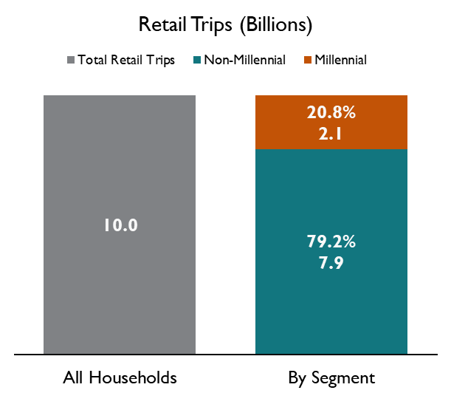
Avocado-purchasing households made 10 billion trips to U.S. retailers in 2018. Millennial households accounted for 21% of those 10 billion trips
Retail Trips for Avocado-Purchasing Households (Billions)
Neither group of shoppers purchased avocados during every trip
Households that purchase avocados made 10 billion retail trips in 2018.
Avocado shoppers did not purchase avocados during each of these 10 billion trips
Millennial households that purchase avocados made 2.1 billion retail trips in 2018, accounting for 20.8% of total retail trips
Conversely, Non-Millennial households that purchase avocados made 7.9 billion retail trips in 2018, account for 79.2% of total retail trips
Data Source: IRI Consumer NetworkTM 2018 (All figures are rounded)

Slide 9
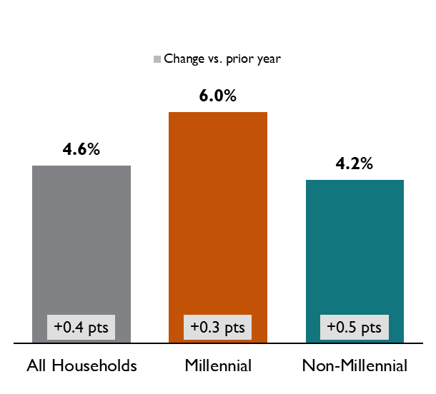
Among avocado-purchasing households, Millennial trips to the retailer were more likely to include an avocado purchase
Retail Trips for Avocado-Purchasing Households (Billions)
Avocado Trip Incidence Among Buyers
Avocado-purchasing households made an avocado purchase (trip incidence) during 4.6% of their 10 billion retail trips.
Millennial avocado-purchasing households made an avocado purchase during 6.0% of their 2.1 billion retail trips
Non-Millennial households made an avocado purchase during 4.2% of their 7.9 billion trips
Trip incidence increased for Millennials (+0.3 pts.) and Non-Millennials (+0.5 pts.) in 2018.
Data Source: IRI Consumer NetworkTM 2018 vs. 2017 (All figures are rounded)

Slide 10
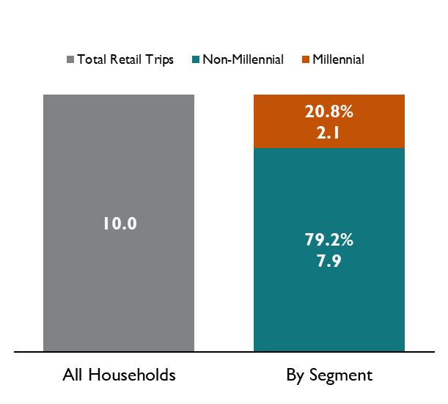
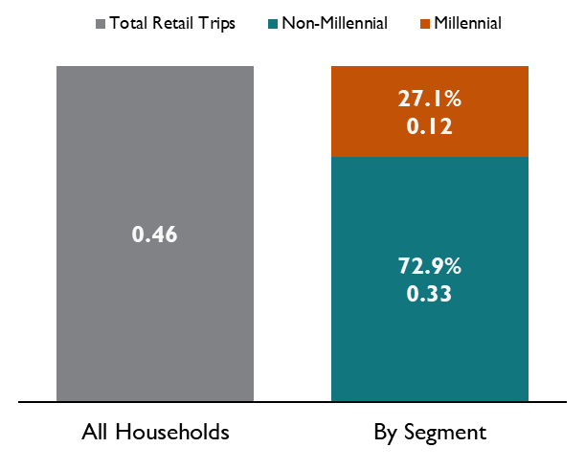
While Millennials accounted for 21% of total avocado-purchasing household retail trips, they accounted for a higher proportion of avocado purchase occasions (27%)
Retail Trips for Avocado-Purchasing Households (Billions)
Avocado Purchase Occasions
(Billions)
Millennial households that purchase avocados accounted for 20.8% of total retail trips for avocado-purchasing households.
Millennial households that purchase avocados accounted for 27.1% of avocado purchase occasions.
Data Source: IRI Consumer NetworkTM 2018 (All figures are rounded)

Slide 11
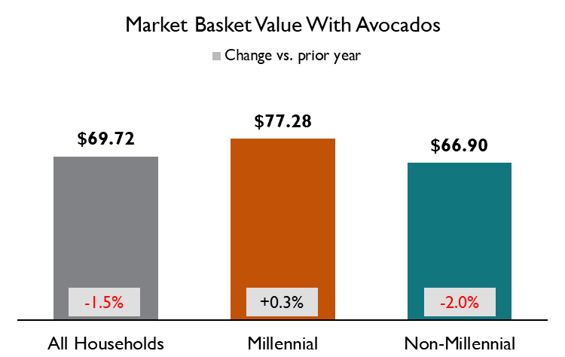
The value of the Millennial market basket with avocados was +16% higher than the Non-Millennial market basket
+$10.38
(+16%)
vs. Non-Millennials
For all households, the retail market basket averaged $69.72 when avocados were included in the basket.
The Millennial market basket averaged $77.28 when avocados were included in the basket, which was +16% higher than the Non-Millennial market basket average of $66.90.
Millennial households showed a +0.3% increase in their market basket value with avocados, while Non-Millennial households showed a -2.0% decline (vs. prior year)
Data Source: IRI Consumer NetworkTM 2018 vs. 2017 (All figures are rounded)

Slide 12
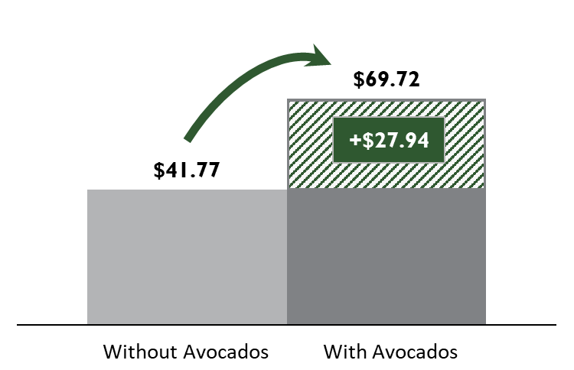
All avocado-purchasing households show an average avocado In-Basket Premium* of +$27.94 (+66.9%)
Avocado Category In-Basket Premium for All Households
When Avocados were included in the basket, Market Basket value increased +$27.94
The value of the Market Basket when Avocados were included in the basket was $69.72. When Avocados were not included in the basket, the value was $41.77. This translates to an In-Basket Premium of +$27.94 or 66.9%.
The next slide shows that this premium is even greater for Millennial households.
*Value of market basket when Avocados are in the basket vs. when Avocados are not in the basket

Slide 13
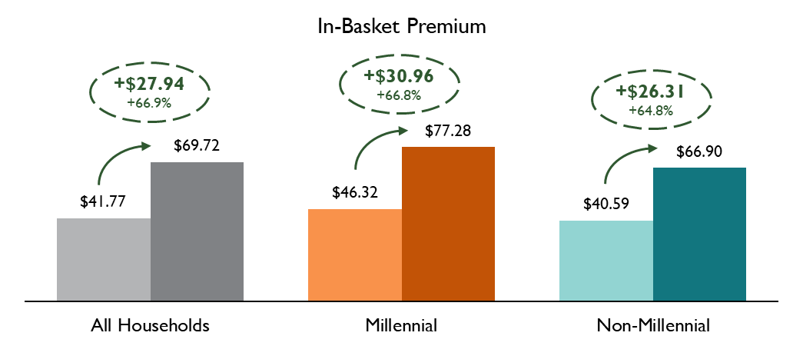
Millennial household In-Basket premium was +$30.96, +$4.65 higher than Non-Millennial households
Millennial household market basket value increased +66.8% when avocados were included in the basket. This translates to an In-Basket premium of +$30.96.
Non-Millennial household market basket value increased +64.8% when avocados were included in the basket. This translates to an In-Basket premium of +$26.31.
The Millennial household In-Basket Premium of +$30.96 was +$4.65 higher than the Non-Millennial In-Basket Premium of +$26.31
Data Source: IRI Consumer NetworkTM 2018 (All figures are rounded)

Slide 14
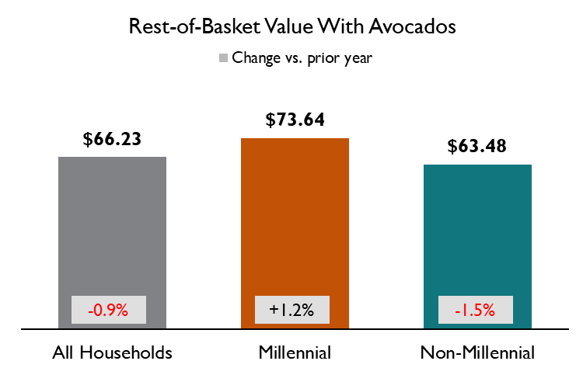
Rest-of-Basket value was also higher for Millennial households vs. Non-Millennial households
+$10.16
(+16%)
vs. Non-Millennials
For all households, the Rest-of-Basket value averaged $66.23 when avocados were included in the basket.
The Millennial Rest-of-Basket value averaged $73.64 when avocados were included in the basket, which was +16% higher than the Non-Millennial market basket average of $63.48.
Millennial households showed a +1.2% increase in their Rest-of-Basket value with avocados, while Non-Millennial households showed a -1.5% decline (vs. prior year)
Data Source: IRI Consumer NetworkTM 2018 vs. 2017 (All figures are rounded)
*Rest-of-Basket measures the value of the other, non-avocado items in the basket when avocados are in the basket

Slide 15
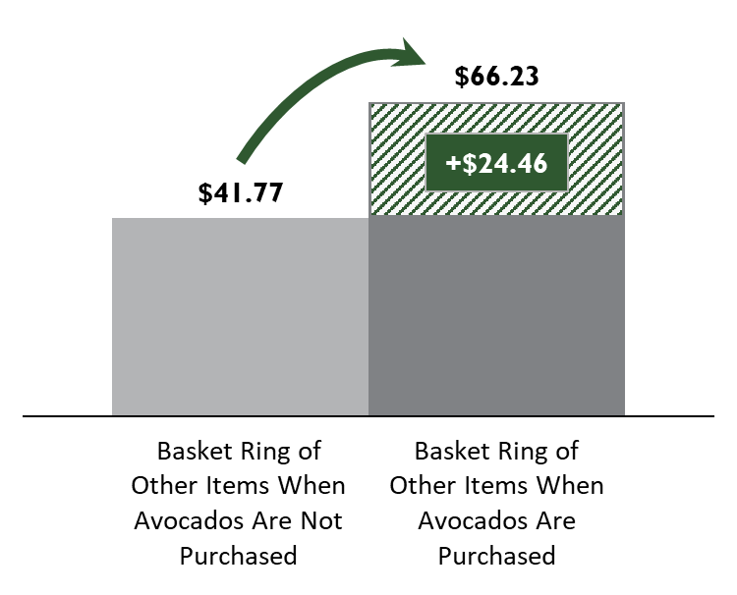
All avocado-purchasing households show an average avocado Rest-of-Basket Premium* of +$24.46 (+58.6%)
Avocado Category Rest-of-Basket Premium for All Households
When Avocados were included in the basket, the market basket value of all other items increased +$24.46 or +58.6%.
The value of all other items in the Market Basket when avocados were included in the basket was $66.23. When Avocados were not included in the basket, the value was $41.77. This translates to a Rest-of-Basket Premium of +$24.46 or 58.6%.
The next slide shows that this premium is even greater for Millennial households.
*Comparison of the value of other items in the market basket when avocados are in the basket ($66.23) vs. when avocados are not in the basket ($41.77)

Slide 16
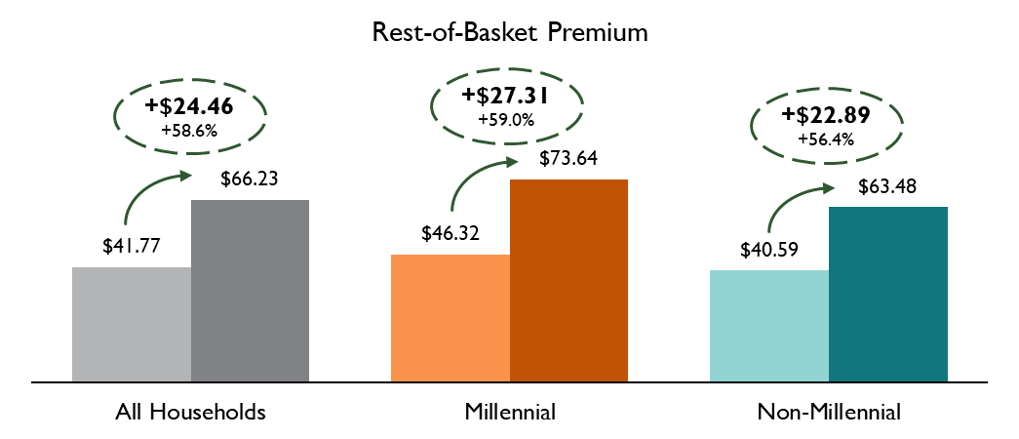
Rest-of-Basket premium is +$4.42 higher for Millennial households vs. Non-Millennial households
Millennial household Rest-of-Basket value increased +59.0% when avocados were included in the basket. This translates to a Rest-of-Basket premium of +$27.31.
Non-Millennial household Rest-of-Basket value increased +56.4% when avocados were included in the basket. This translates to a Rest-of-Basket premium of +$22.89.
The Millennial household In-Basket Premium of +$27.31 was +$4.42 higher than the Non-Millennial In-Basket Premium of +$22.89
Data Source: IRI Consumer NetworkTM 2018 (All figures are rounded)

Slide 17
What’s in the basket with avocados?
Market Basket Affinity

Slide 18
Fresh produce was often found in the avocado market basket. Below are the top twenty items found in the basket with avocados.
Icons highlight the 10 categories in the top 20 that have the strongest affinity indexes*
Affinity
Index:
394
599
440
239
401
300
506
377
310
593
458
216
604
377
230
422
298
322
438
249
Eleven of the top 20 most often found items in the avocado market basket are fresh produce items.
All items in the top 20 have strong affinity indexes, indicating that these items showed up in avocado market baskets significantly more often than was expected.
Icons highlight the 10 categories in the top 20 that have the strongest affinity indexes, 9 of which were fresh produce categories.
Data Source: IRI Consumer NetworkTM 2018 (All figures are rounded)
*Affinity index measures which items were more likely to be found with avocados than was expected
Icons made by Freepik from www.flaticon.com

Slide 19
The top 20 items in Millennial and Non-Millennial avocado baskets were virtually the same, including many fresh produce items
Top 20 Avocado Trip Incidence
Millennial Households
Non-Millennial
Households
Apples
Bananas, Berries
Carrots, Cereal,
Crackers, Cucumbers,
Fresh Bread, Fresh Cut Salad, Fresh Eggs, Lettuce,
Onions, Peppers, Potatoes, Yogurt, Shredded Cheese, Skim Milk, Tomatoes,
Tortilla Chips
Tortillas
Cookies
Data Source: IRI Consumer NetworkTM 2018 (All figures are rounded)

Slide 20
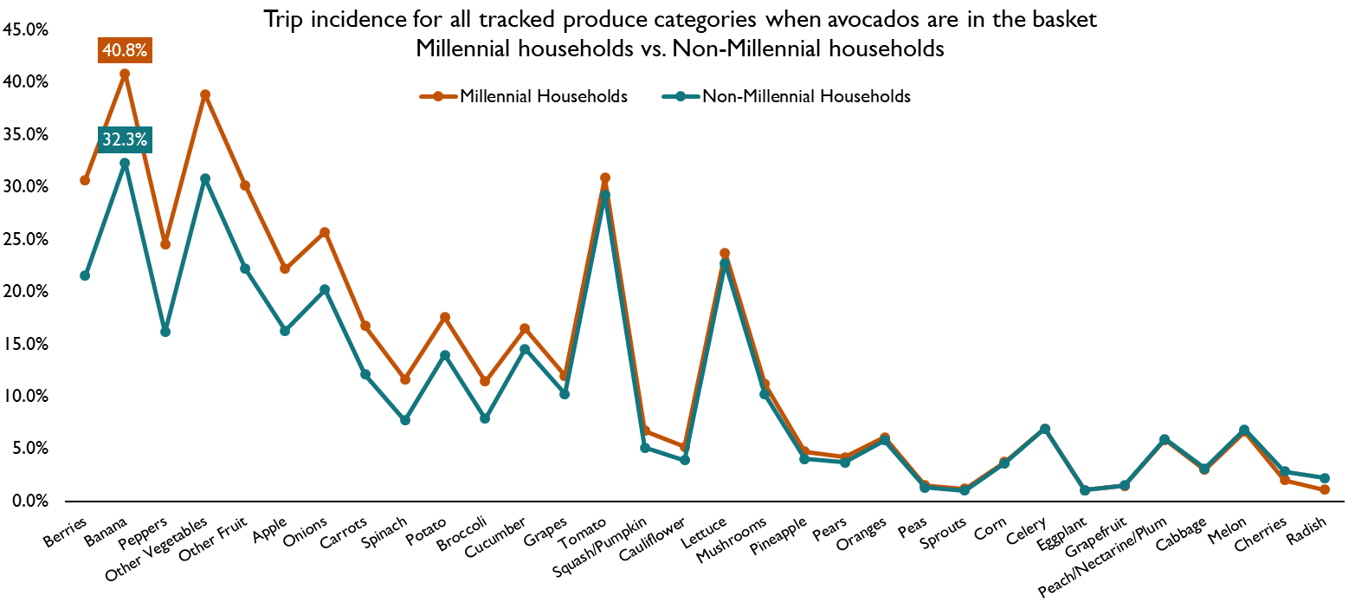
Many fresh produce items are more often found in Millennial avocado baskets than in Non-Millennial avocado baskets
Millennial households show a higher trip incidence for many fresh produce categories when avocados are in the basket. For example: Bananas are in 40.8% of millennial avocado market baskets, but only 32.3% of Non-Millennial avocado market baskets, a gap of +8.5 points.
Conversely, there are significantly fewer produce items that show up in Non-Millennial avocado baskets more often than Millennial avocado baskets. Radish shows the biggest gap at -1.1 points
Data Source: IRI Consumer NetworkTM 2018 (All figures are rounded)

Slide 21
Terms and Definitions
Shopper Household Groups
Millennial Households: Head of household born 1981-96 (ages 22-37 in 2018)*
Non-Millennial Households: All other households (18+)
Total Households
Metrics: All figures in this report are rounded
Household Penetration – Percentage of total U.S. households that purchase the category
Buyer Rate (Annual Spend per Category-Buying Household) – Average annual spend on the category per category-buying household. Annual Spend = Number of Trips X Spend per Trip
Number of Trips – Average annual category purchase occasions per category-buying household
Purchases – Throughout this report, “Purchases” refers to dollar purchases. Volume/units/eaches are not available
Retail Trips – Number of retail purchase trips by avocado-purchasing households in the following retail channels: Grocery, Mass/Supercenter, Walmart, Club, Dollar, Internet, Drug, Military, Misc.
Trip Incidence: Percentage of trips in the above channels that include avocados
Market Basket Value – Average dollar ring per shopping trip. Calculated with and without avocados
In-Basket Premium – Incremental value of the Market Basket when avocados are in the basket
Rest-of-Basket Value – Average value of the other (non-avocado) items in the basket when avocados are in the basket
Rest-of-Basket Premium – Incremental value of other items in the basket when avocados are in the basket
Affinity index – Measures which items were more likely to be found with avocados than was expected
Time Periods:
Current Year (CY) – 2018 Calendar year
Prior Year (PY) – 2017 Calendar year
Source Data:
IRI Consumer NetworkTM 2018 (Details on page 22)
Fusion Marketing: Study development
*http://www.pewresearch.org/topics/millennials/

Slide 22
Data Source: IRI Consumer NetworkTM
This report is based on household purchasing data from the IRI Consumer NetworkTM. IRI receives its household purchasing data from the National Consumer Panel (NCP), an operational joint venture by IRI and Nielsen. The NCP is a continuous household purchasing consumer panel that consists of a representative sample of U.S. households who electronically record all purchases. Households are recruited to the NCP and are incented to record all of their purchases, regardless of where purchased, using a handheld in-home scanning device.
Household purchasing data complements retail sales data and provides a deeper understanding of category dynamics by focusing on shoppers and their purchase behaviors. In turn, understanding shopper purchase behaviors helps uncover opportunities for growth and aids in effective sales and marketing decisions.
In-store purchases
Electronically recorded at home

Slide 23
Thank you
For additional retail information and insights please visit the Hass Avocado Board website at:
hassavocadoboard.com

Slide 24
Appendix

Slide 25
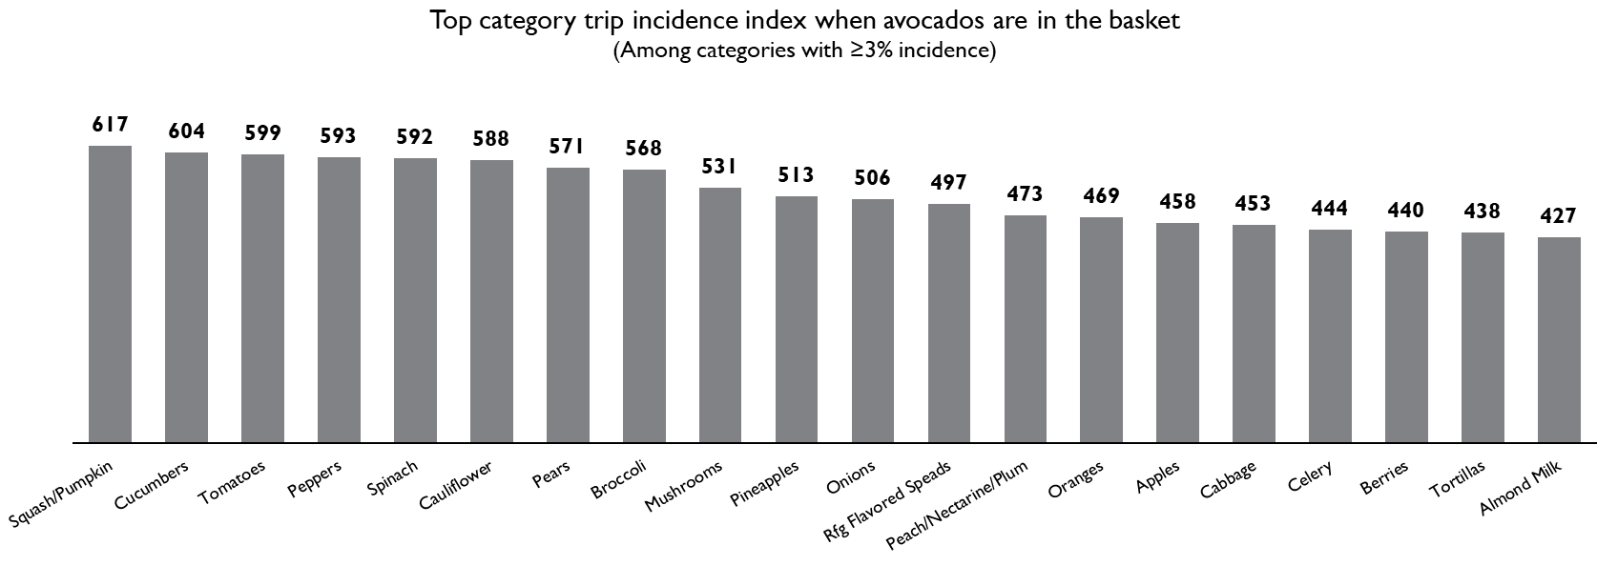
Top 20 Items that avocado-purchasing households cross-purchase significantly more often than expected
Data Source: IRI Consumer NetworkTM 2018 (All figures are rounded)

Slide 26
Top twenty items found in the Millennial Market Basket
Data Source: IRI Consumer NetworkTM 2018 (All figures are rounded)

Slide 27
Top 20 Items that Millennials cross-purchase significantly more often than expected
Data Source: IRI Consumer NetworkTM 2018 (All figures are rounded)

Slide 28
Top twenty items found in the Non-Millennial Market Basket
Data Source: IRI Consumer NetworkTM 2018 (All figures are rounded)

Slide 29
Top 20 Items that Non-Millennials cross-purchase significantly more often than expected
Data Source: IRI Consumer NetworkTM 2018 (All figures are rounded)

