Slide 1
Long Term Avocado Purchase Trends
Building the Path to Dynamic Avocado Category Growth
Long Term Avocado Category Growth and Opportunities to Drive Sales of Hass Avocados

Slide 2
Table of Contents
Objective and Executive Summary | 3
Key Insights and Opportunities | 6
Methodology: Avocado Segmentation | 8
Avocado Purchase Trends: Total Households | 11
Avocado Purchase Trends: Hispanic vs. Non-Hispanic | 25

Slide 3
Objective and Executive Summary
Objective
The objective of this study is to identify data-based insights and growth opportunities for the avocado category based on the long-term purchase trends of retail avocado shoppers. Specifically, this study measures the impact of heavily involved avocado shoppers on long-term category growth compared to shoppers that are less involved in the category. Additionally, this study uncovers the underlying purchase trends of Hispanic and Non-Hispanic avocado shoppers and examine their current and future roles in the growth of the avocado category.
Executive Summary
The avocado category has experienced substantial retail sales growth over the past four years and ranks as one of the largest categories in fresh produce. This growth comes in the form of new shoppers entering the category and shoppers making additional trips to the retailer to purchase avocados. These category dynamics are pushing avocado shoppers “up the ladder” to greater purchase levels as their annual spend per household increases.
The avocado category saw an increase of +$250M in purchases from 2016 to 2019. Super avocado-purchasing households drove 94% of this increase and Heavy households drove 6%. Medium and Light households saw a decline in purchases over the long term.
Continued on next page…
Source: IRI Consumer NetworkTM 2020 (All figures are rounded)

Slide 4
Executive Summary Cont.
The increase in Super household purchases was driven by two factors:
Shoppers moving up the purchase ladder. The Super segment grew by +3.2M households, accounting for 28% of all avocado-purchasing households in 2019, up from 25% in 2016
  One of the primary drivers of this trend is frequency of purchase. As shoppers move up the ladder, their purchase trips increase. Purchase trips increased +9%, while spend per trip increased +3% (Spend per trip may be impacted by pricing dynamics in the marketplace)
Annual spend per household increased +5% for the Super segment. This annual spend increase was driven by an increase in spend per trip (+2%) and purchase trips (+3%)
Super households also spend more in store on all items in the market basket than other groups. Supers spend $74.43, which is +3% more than Heavy households and +13% more than Light households. Despite this additional spend, avocados comprise a greater proportion of the Super group’s market basket than they do in other segments. Avocados comprise 4.6% of Super baskets, but only 2.4% of Light baskets
These trends make the Super segment increasingly important to the growth of the avocado category and a particularly important shopper segment to retailers and the industry.
Continued on next page…
Source: IRI Consumer NetworkTM 2020 (All figures are rounded)

Slide 5
Executive Summary Cont.
Hispanic shoppers are a high-value segment of the avocado category. This shopper group is more likely to purchase avocados than Non-Hispanic households. They purchase avocados more often, and they spend more per trip. However, the growth in incremental avocado purchases from 2016-2019 (+$250M) was driven by Non-Hispanic households.
Non-Hispanic households drove 76% of long-term category growth over the last four years. This group comprises a much larger proportion of households and their purchase trends increased at a faster rate than Hispanic households: Non-Hispanics account for 83% of total U.S. households and their average annual household spend increased +14%, while Hispanic spend increased +9%.
The primary driver of the growth in annual household spend was an increase in category purchase trips: Non-Hispanic purchase trips increased +10%, while Hispanic purchase trips increased +6%.
As marketers and retailers look to the future of the avocado category, the data suggests a significant opportunity for growth, particularly in the Non-Hispanic shopper group. Non-Hispanic household penetration was 61% in 2019, compared to 85% for Hispanic households. However, the potential for growth in Non-Hispanic penetration is greater than the potential for Hispanic penetration: The growth potential of a +1-point increase in Non-Hispanic penetration is an additional +$24M in annual purchases, compared to +$4M for Hispanic households.
These trends signify the value of Hispanic and Non-Hispanic avocado shoppers. Hispanic shoppers may be a smaller household group, but they are a high-value segment in the category. Non-Hispanic households show significant potential to drive new category growth as the industry looks to the future.
Source: IRI Consumer NetworkTM 2020 (All figures are rounded)

Slide 6
Key Insights
Key Insight: P. 13
Super avocado-purchasing households accounted for 94% of category growth from 2016-2019.
Key Insight: P. 16, 17
Avocado shoppers are moving up the purchase ladder. The Super and Heavy segments are growing and gaining share of households.
Key Insight: P. 21
As avocado shoppers shift to higher purchase levels, the category has shown an increase in avocado purchase trips, which is driving category growth.
Key Insight: P. 34
Hispanic households are a high-value avocado segment, as they outspend Non-Hispanics on a per household basis. However, Non-Hispanic households are catching up.
Key Insight: P. 27, 28, 33
Non-Hispanic households are driving category growth. Non-Hispanics accounted for 76% of category growth due to the size of the segment. Non-Hispanics make up 83% of avocado-purchasing households and they represent a strong opportunity for category growth through increasing penetration. A +1 point increase in Non-Hispanic penetration would drive +$23.7M in incremental category purchases. In contrast, a +1 point increase in Hispanic penetration would drive +$4.5M in incremental category purchases.

Slide 7
Key Actions and Opportunities
Key Opportunity
Continue to Increase Avocado Shopper Trips to the Retailer
The increase in avocado purchase trips was a key driver of category growth from 2016-2019. Bringing new shoppers into the category and driving more trips to the retailer continue to be key opportunities for sustained growth in the avocado category.
Key Opportunity
Focus on Super and Heavy Shopper Segments
Super and Heavy shoppers drove 100% of the long-term growth in the category from 2016-2019. Super shoppers made a particularly strong impact on the category, controlling 70% of total category purchases and driving 94% of growth. Understanding and engaging these shoppers is key to ushering in the next wave the category growth.
Key Opportunity
Recognize the Value of Hispanic and Non-Hispanic Shoppers
Hispanic avocado shoppers are currently more likely to purchase avocados than Non-Hispanics and outspend them on a per household basis. This makes Hispanic households a high-value shopper segment in the avocado category. However, Non-Hispanics make up 83% of avocado-purchasing households and they are closing the spending gap vs. Hispanics. These shifting trends resulted in significant growth from Non-Hispanic households. Non-Hispanics drove 76% of category growth from 2016-2019.
Source: IRI Consumer NetworkTM 2020 (All figures are rounded)

Slide 8
Avocado Segmentation
Methodology

Slide 9
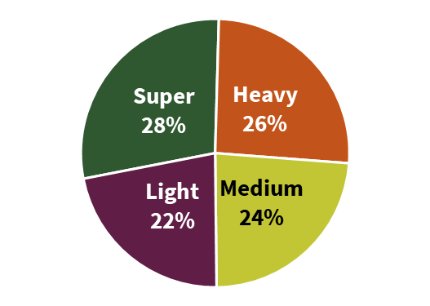
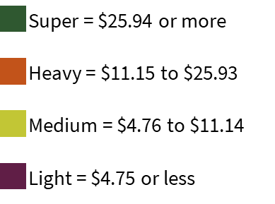
Segmentation
Avocado Shopper Segmentation* (Households)
Segment Annual Household Avocado Spend Ranges
Super households spent $25.94 or more annually on avocados
Heavy households spent between $11.15 to $25.93 annually
Medium households spent between $4.76 to $11.14 annually
Light households spent $4.75 or less annually
*This segmentation was first conducted in 2016.
The current distribution of avocado-purchasing households was calculated using the 2016 definitions
Source: IRI Consumer NetworkTM 2020 (All figures are rounded)

Slide 10
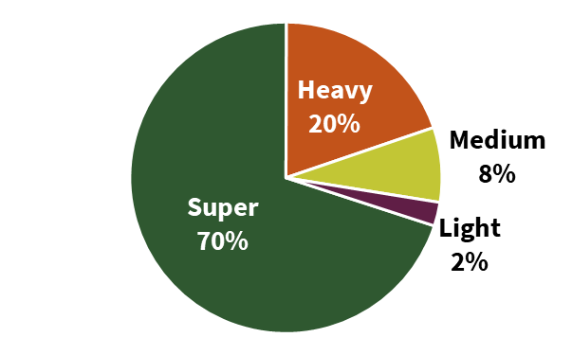
Super households make 70% of all avocado purchases
Avocado Shopper Segmentation
(Households)
(Purchases)
While Super households comprise just over one quarter (28%) of all avocado-purchasing households, they make nearly three quarters (70%) of all avocado purchases
Heavy households make 20% of all avocado purchases. Combined, these top-two segments (Super and Heavy) account for 54% of all avocado-purchasing households yet make 90% of all avocado purchases. While all avocado-purchasing households contribute, two groups (Super and Heavy) are particularly involved in and important to category growth
In contrast, the remaining half of all avocado-purchasing households (Medium and Light combined), account for only 10% of all avocado purchase dollars
Source: IRI Consumer NetworkTM 2020 (All figures are rounded)

Slide 11
Total HOUSEHOLDS
Avocado Purchase Trends

Slide 12
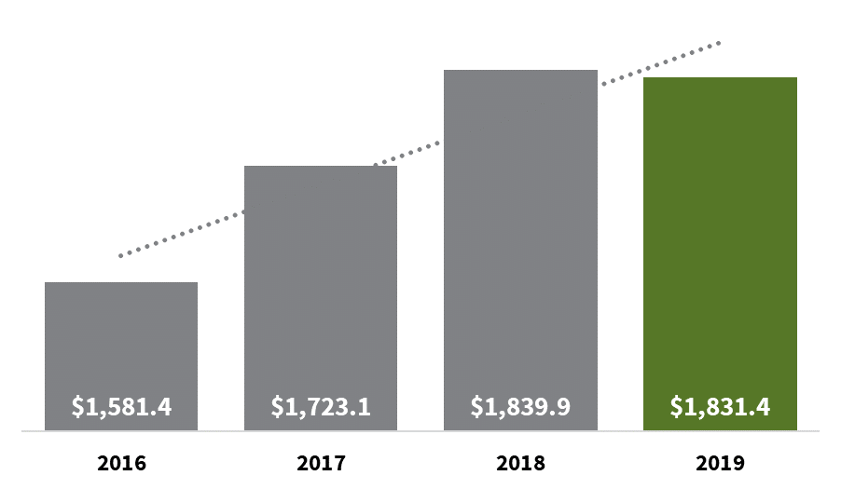
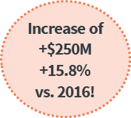
2019 Avocado purchases grew +$250M since 2016
Total Household Avocado Purchase Dollars (Millions)
2019 avocado purchases increased +15.8% vs. 2016, a compound annual growth rate of +5%
This dollar growth equated to +$250M in avocado purchases
Source: IRI Consumer NetworkTM 2020 (All figures are rounded)

Slide 13
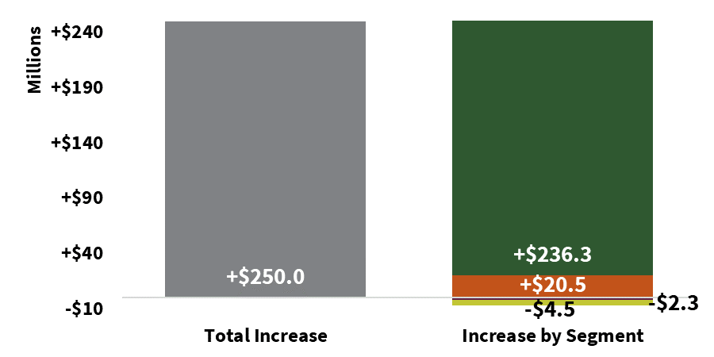
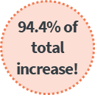
Super households contributed more than 90% of the $250M purchase gain from 2016-2019
Incremental Avocado Purchases (2016 vs. 2019)
Super and Heavy household purchases increased from 2016-2019
Super households contributed +$236.3M in incremental purchases
Heavy households contributed +$20.5M in incremental purchases
Combined, these segments (Super and Heavy) contributed 100% of the growth in purchases
Source: IRI Consumer NetworkTM 2020 (All figures are rounded)

Slide 14
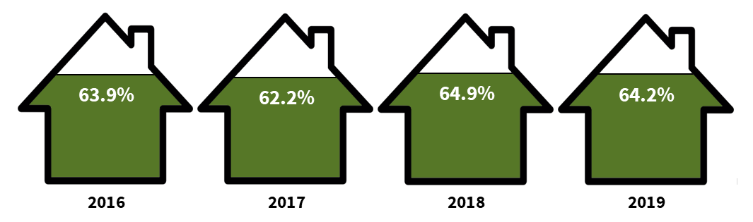
Household penetration reached 64.2% in 2019, up from 62.2% in 2017
Household Penetration
64% of U.S. households purchased avocados in 2019, equating to 80M households
Household penetration has grown steadily over past years, but was relatively flat in 2019 vs. 2018
Penetration increased from a 4-year low of 62.2% in 2017
62.24%
Source: IRI Consumer NetworkTM 2020 (All figures are rounded)

Slide 15
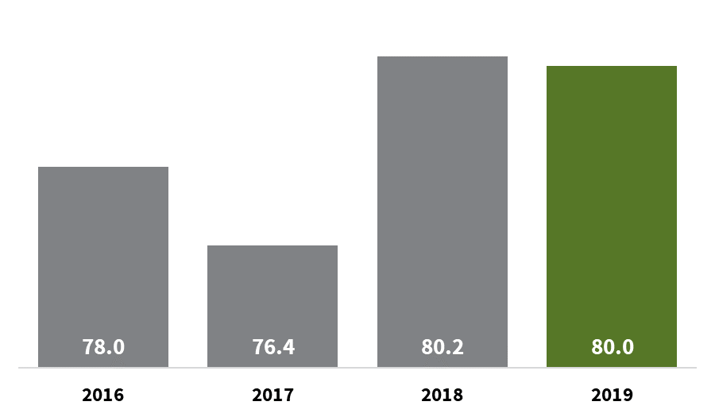
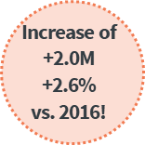
The steady increase in household penetration brought additional buyers into the category
Total Avocado-Purchasing Households (Millions)
80M households purchased avocados in 2019, an increase of +2.6% vs. 2016
This increase equated to +2.0M additional households entering the category
Source: IRI Consumer NetworkTM 2020 (All figures are rounded)

Slide 16
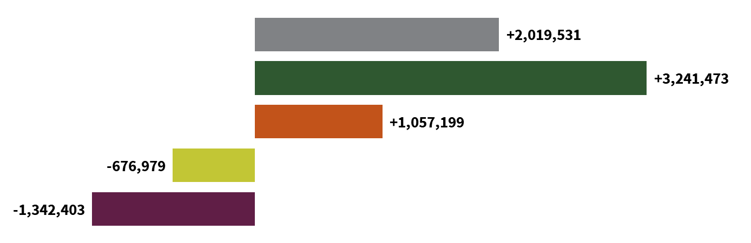
The Super segment grew by +3.2 million buyers from 2016-2019
Incremental Avocado-Purchasing Households (2106 vs. 2019)
The Super and Heavy segments each saw a considerable increase in buyer count from 2016-2019
  The Super segment increased by +3.2M households
  The Heavy segment increase by +1.1M households
Medium and Light segments saw an incremental decrease in households. This decline may indicate movement up the purchase ladder to Heavy and Super segments
Source: IRI Consumer NetworkTM 2020 (All figures are rounded)

Slide 17
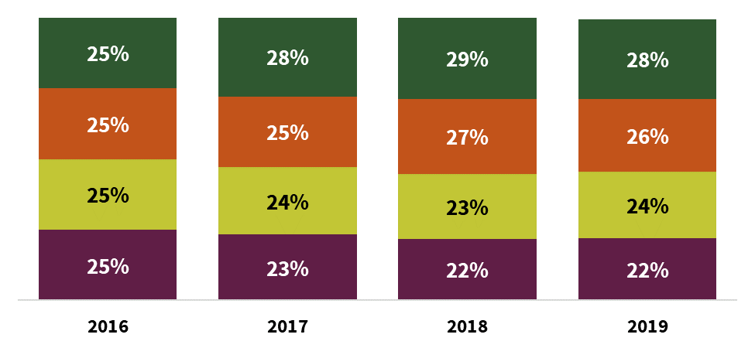
The Super and Heavy segments gained household share
Avocado Shopper Segmentation (Households)
Super households gained share over the last four years. Currently, 28% of avocado-purchasing households spend $25.94 or more annually, whereas in 2016, only 25% of total avocado-purchasing households spent at this level
Over this same period, the Heavy segment gained one share point, while Medium and Light segments contracted
Source: IRI Consumer NetworkTM 2020 (All figures are rounded)

Slide 18
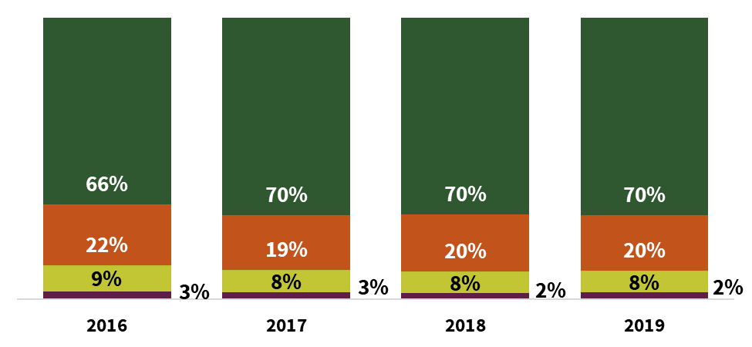
The Super segment saw an increase in share of purchases in 2017 (vs. 2016) and has since remained flat
Avocado Segment Shares (Purchases)
As the Super segment gained share of households, their share of purchases also increased
Super households accounted for 70% of all avocado purchases in the U.S. in 2019 an increase of +4 share points vs. 2016
However, the Super segment share of avocado purchases has remained flat since 2017
Source: IRI Consumer NetworkTM 2020 (All figures are rounded)

Slide 19
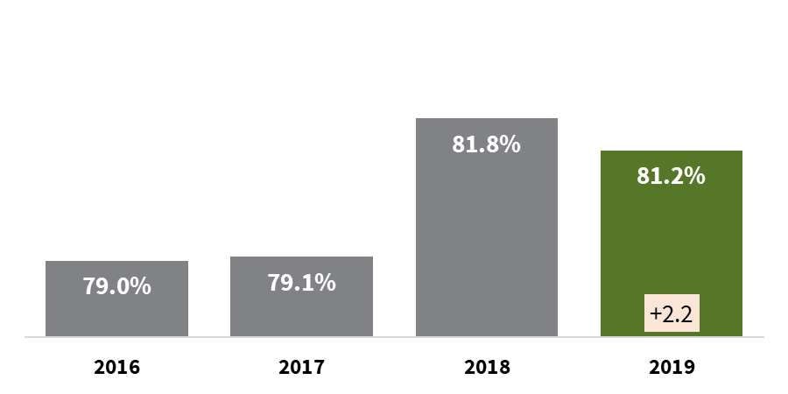
Repeat buyer rate has increased over the past four years
Percent of Households Who Buy More Than Once Per Year (Repeat Buyers)
Point change versus 2016
Indicates highest annual Repeat
Buyer rate for each group
Repeat buyer rate was highest in 2018, with a very slight dip in 2019 to 81%
Nearly 100% of Super and Heavy households purchase avocados more than once per year
Source: IRI Consumer NetworkTM 2020 (All figures are rounded)

Slide 20

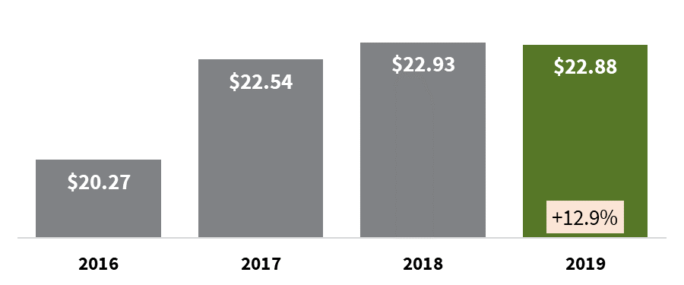
The Super segment drove an increase in total annual avocado spend per household
Average Annual Household Spend
Percent change versus 2016
Indicates highest annual Repeat
Buyer rate for each group
Average annual avocado spend per household grew to $22.88 in 2019, a +12.9% increase vs. 2016
This gain was driven by an increase in Super spend per household (+5.1% vs. 2016)
Source: IRI Consumer NetworkTM 2020 (All figures are rounded)

Slide 21


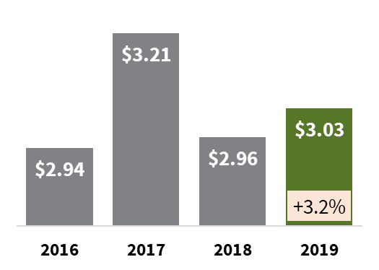
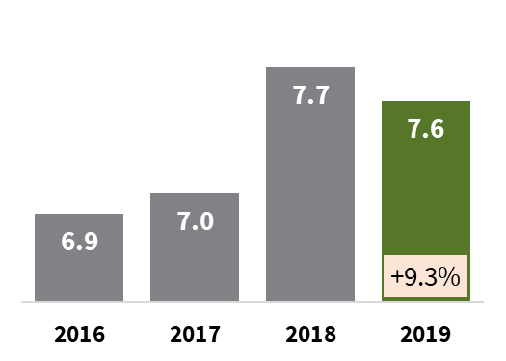
Avocado shoppers are making more purchase trips per year
Average Annual Household Spend Per Trip
Average Annual Household Purchase Trips
% change
versus 2016
Indicates highest Annual Household
Spend or Trips for each group
The increase of +12.9% in total average annual spend per household was primarily driven by an increase in annual purchase trips (+9.3%)
2019 spend per trip also increased vs. 2016 (+3.2%), however the year-to-year fluctuations in spend per trip are relatively flat and may be impacted by retail price trends
Source: IRI Consumer NetworkTM 2020 (All figures are rounded)

Slide 22

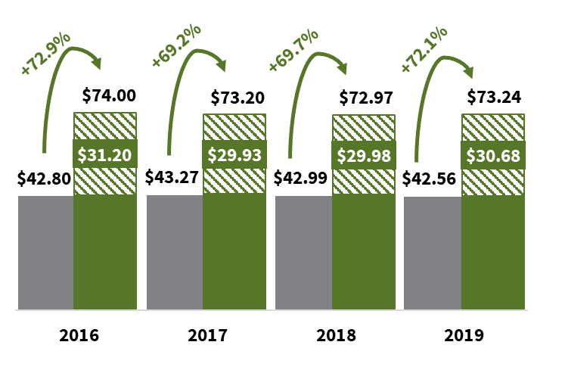

Avocados increased market basket value by +72% in 2019
Market Basket Value
Without Avocados vs. With Avocados
In 2019, the premium was +72.1%. The premium has remained relatively unchanged for total avocado-purchasing households
Market basket premium has declined for Super, Medium and Light households, but has increased for Heavy households
Indicates highest annual Market
Basket Increase for each group
Source: IRI Consumer NetworkTM 2020 (All figures are rounded)

Slide 23
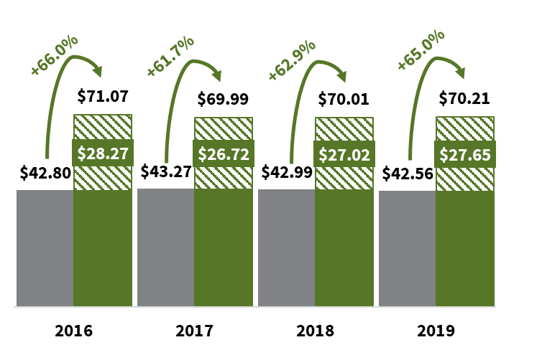
Rest-of-basket value* also increases when avocados are included
Rest of Market Basket Value
Without Avocados vs. With Avocados
In 2019, the rest-of-basket premium was +65.0% when avocados were included. This premium has remained relatively unchanged for total avocado-purchasing households
Rest-of-basket premium has declined for Super, Medium and Light households, but has increased for Heavy households
+65.0%
premium!
Indicates highest annual Rest of
Market Basket Increase for each group
Source: IRI Consumer NetworkTM 2020 (All figures are rounded) *Rest-of-basket value = the value of all other non-avocado items in the basket

Slide 24
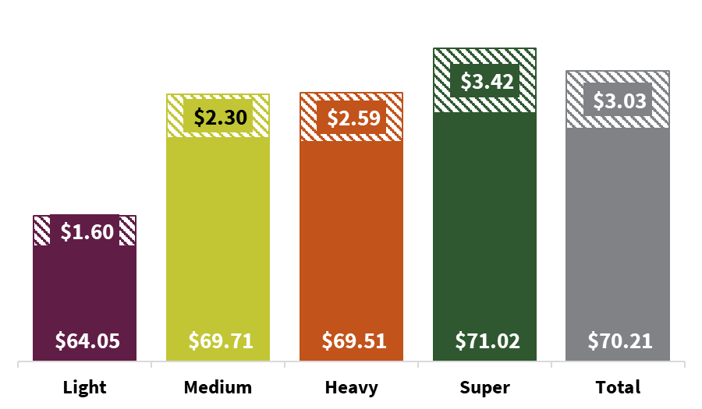

Super households yield a higher market basket spend; this makes them valuable to the retailer
Market Basket Value By Segment (2019)
$74.43
$72.10
$73.24
Super avocado-purchasing households spend more on total market basket vs. other segments.
  Supers spend $74.43 on total basket, +13.4% more than Light households ($65.65)
Despite this higher total spend, avocados make up a larger proportion of Super baskets then all other segments
  2019 Avocado Share of Basket
  Super: 4.6%
  Heavy: 3.6%
  Medium: 3.2%
  Light: 2.4%
$72.02
$65.65
Avocado Share
4.1%!
Indicates highest annual Market Basket
avocado share for each group
Source: IRI Consumer NetworkTM 2020 (All figures are rounded)

Slide 25
Hispanic vs. non-Hispanic
Avocado Purchase Trends

Slide 26
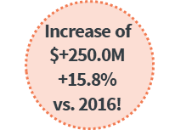
2019 Avocado purchases grew +$250M since 2016
Total Household Avocado Purchase Dollars (Millions)
2019 avocado purchases increased +15.8% vs. 2016, a compound annual growth rate of +5%
This dollar growth equated to +$250M in avocado purchases
Source: IRI Consumer NetworkTM 2020 (All figures are rounded)

Slide 27
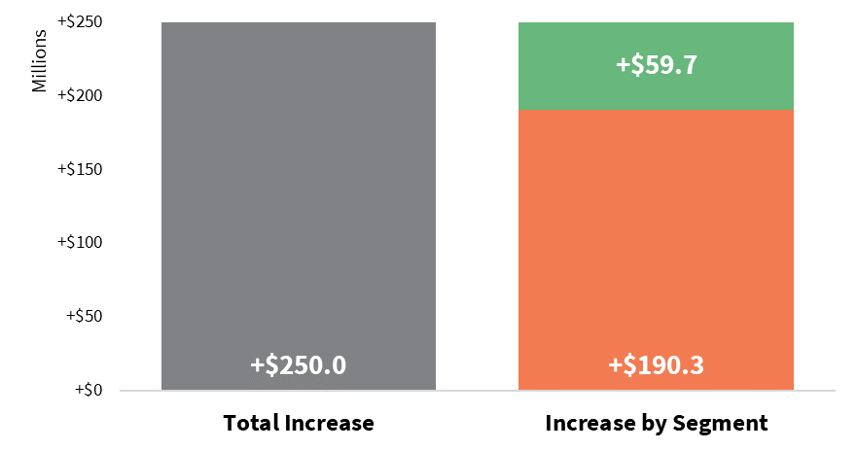

Non-Hispanic households contributed three-fourths of the $250M gain
Incremental Avocado Purchases (2016 vs. 2019)
Non-Hispanic households showed a +$190M increase in avocado purchases, contributing 76% of the total $250M gain
Hispanic households showed a +$60M increase in avocado purchases, contributing 24% of the total $250M gain
Source: IRI Consumer NetworkTM 2020 (All figures are rounded)

Slide 28
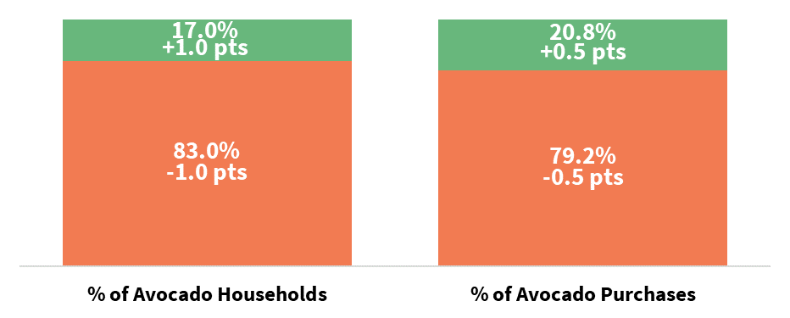

Hispanic households account for a greater proportion of avocado purchases than they do of avocado-purchasing households
Household Shares
Hispanic vs. Non-Hispanic
Hispanic shoppers account for 17.0% of avocado-purchasing households and account for an even greater share of avocado purchases (20.8%)
Source: IRI Consumer NetworkTM 2020 (All figures are rounded)

Slide 29
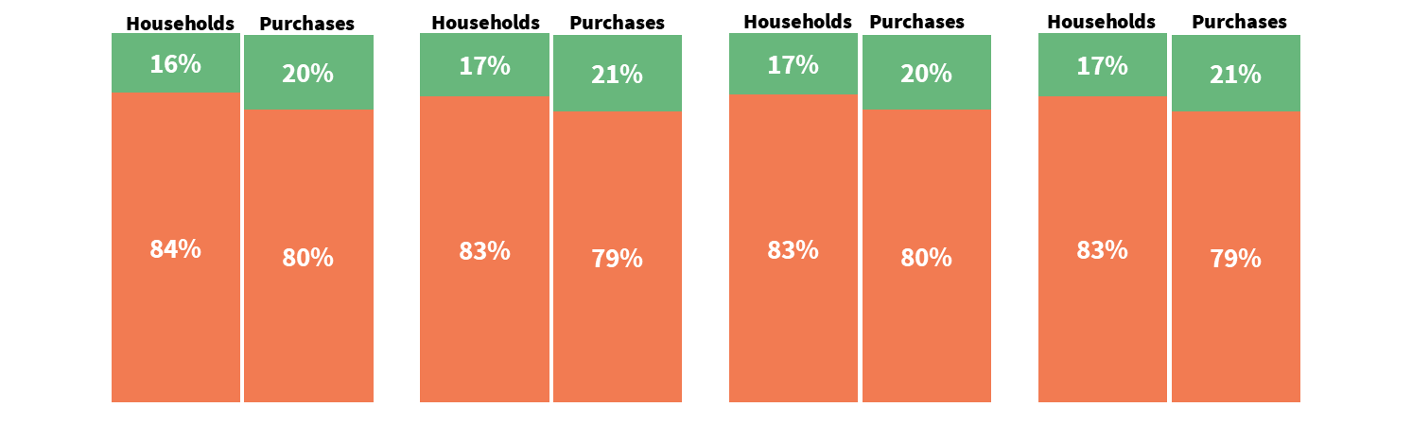
Hispanic household shares have remained relatively unchanged for the past four years
Total Household and Dollar Shares By Segment and Year
2016
2017
2018
2019
In 2019, Hispanic households made 21% of all Date purchases, a +1 point increase over 2016 (20%)
In 2019, Hispanic households accounted for 17% of avocado-purchasing households, a +1 point increase over 2016 (16%)
Source: IRI Consumer NetworkTM 2020 (All figures are rounded)

Slide 30
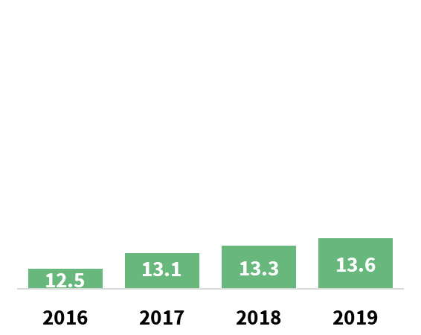
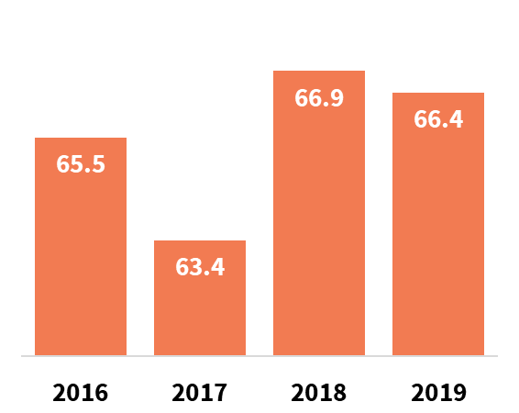
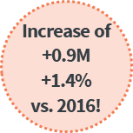
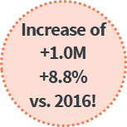
The number of Hispanic and Non-Hispanic households has increased over the last four years
Total Hispanic Avocado-Purchasing Households (Millions)
Total Non-Hispanic Avocado-Purchasing Households (Millions)
The number of Hispanic avocado-purchasing households has increased each year for the past 4 years, resulting in an +8.8% increase (2019 vs. 2016)
The number of Non-Hispanic avocado-purchasing households has fluctuated throughout the past four years, resulting in a +1.4% increase (2019 vs. 2016)
Source: IRI Consumer NetworkTM 2020 (All figures are rounded)

Slide 31
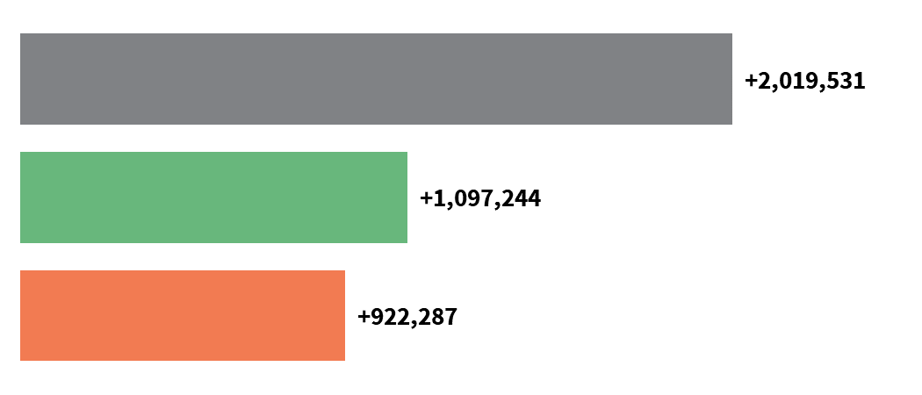
Hispanic avocado-purchasing households increased by +1.1M from 2016-2019
Incremental Avocado-Purchasing Households
(2016 vs. 2019)
Hispanic
Non-Hispanic
Total Households
Hispanic avocado-purchasing households increased by +1.1M (2016 vs. 2019)
Non-Hispanic avocado-purchasing households increased by +0.9M (2016 vs. 2019)
These trends resulted in a total increase of +2.0M avocado-purchasing households
Source: IRI Consumer NetworkTM 2020 (All figures are rounded)

Slide 32
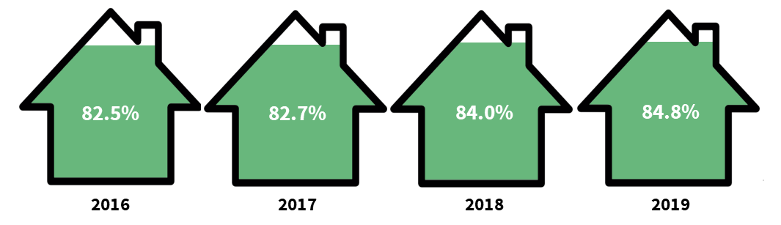
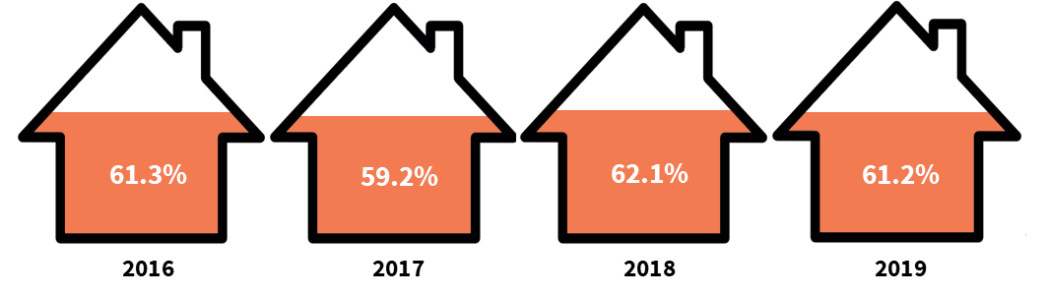
Hispanic household penetration has increased since 2016
Hispanic Household Penetration
Non-Hispanic Household Penetration
84.8% of Hispanic households purchased avocados in 2019, compared to 61.2% of Non-Hispanic households
2019 Hispanic household penetration of 84.8% has increased +2.3 percentage points since 2016, while Non-Hispanic household penetration has remained relatively flat
Source: IRI Consumer NetworkTM 2020 (All figures are rounded)

Slide 33
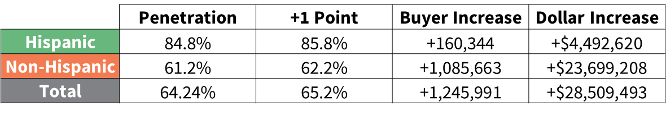
Penetration remains an opportunity for growth in the avocado category
Opportunity for +1 Point Increase in Penetration:
A +1-percentage point increase in Hispanic penetration would bring in +160K households, which equates to +$4.5M in avocado purchases
A +1-percentage point increase in Non-Hispanic penetration would bring in +1.1M households, which equates to +$23.7M in avocado purchases
Source: IRI Consumer NetworkTM 2020 (All figures are rounded)

Slide 34
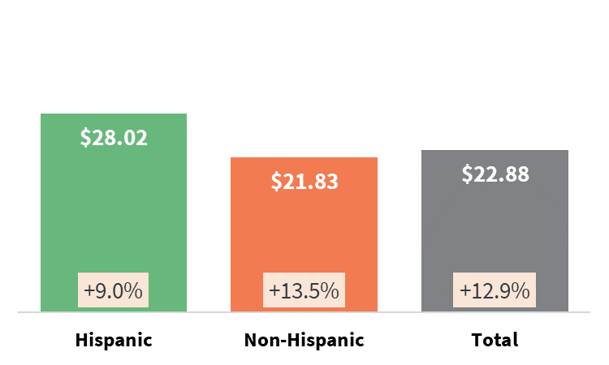
Hispanics spend more per household on avocados than Non-Hispanics, but Non-Hispanics are steadily catching up
Average Annual Household Avocado Spend
(2019)
% change versus 2016
Indicates highest annual
Household Spend for each group
The average annual avocado spend per household is highest for the Hispanic segment ($28.02 in 2019)
This Hispanic rate is 28% higher than the Non-Hispanic rate ($21.83 in 2019). This gap is shrinking, down from 34% in 2016 ($25.71 vs. 19.23)
The respective buying rate for each segment has increased from 2016, with the Non-Hispanic segment showing the highest individual increase of 13.5%
Source: IRI Consumer NetworkTM 2020 (All figures are rounded)

Slide 35
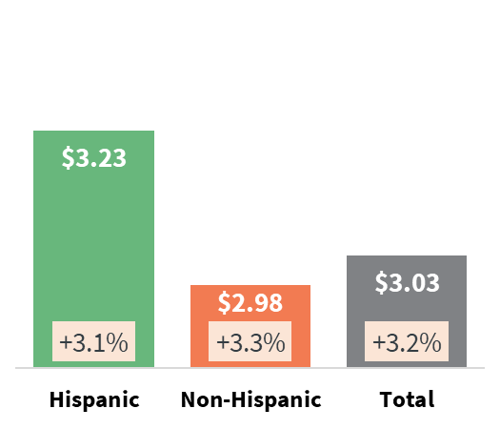
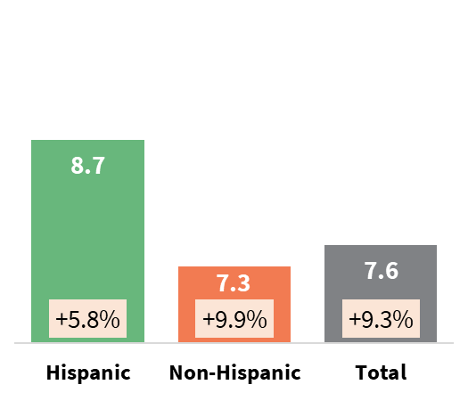
Non-Hispanic household avocado spend per trip and purchase trips have increased at a faster rate than Hispanic households
Purchase Trips (2019)
Spend Per Trip (2019)
% change versus 2016
% change versus 2016
Spend per trip and Number of trips have increase for Hispanic and Non-Hispanic households, but the Non-Hispanic trends are increasing at a greater rate
However, Hispanic households still spend more and purchase avocados more frequently
  Hispanics averaged 8.7 trips per year in 2019 (+19% higher than Non-Hispanics)
  Hispanics spent $3.23 per trip (+8% higher than Non-Hispanics)
Indicates highest annual Household
Spend Per Trip for each group
Source: IRI Consumer NetworkTM 2020 (All figures are rounded)

Slide 36
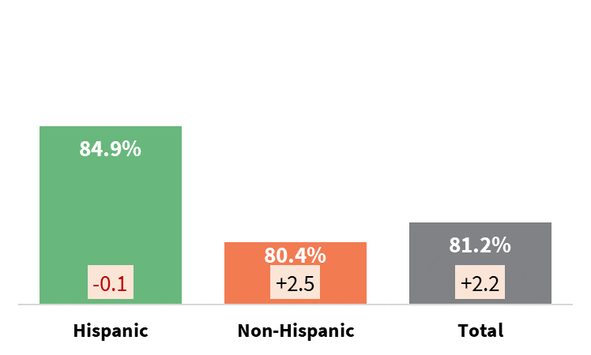
Non-Hispanic repeat buying rate has increased, while the Hispanic rate was relatively flat
Percent of Households Who Buy More Than Once Per Year (Repeat Buyers)
2019
Point change versus 2016
Indicates highest annual Repeat
Buyer rate for each group
A greater proportion of Hispanic households purchase avocados more than once per year than Non-Hispanic households (84.9% vs. 80.4%, respectively)
However, the Non-Hispanic rate has increased +2.5 points vs. 2016, while the Hispanic rate has remained relatively unchanged
Source: IRI Consumer NetworkTM 2020 (All figures are rounded)

Slide 37
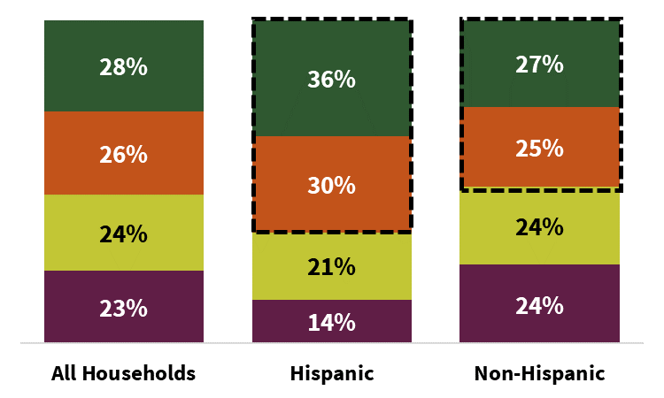
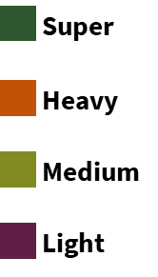
The Super and Heavy segments make up a greater proportion of Hispanic households than Non-Hispanic households
Avocado Shopper Segmentation (Households) (2019)
The Super and Heavy segments combined make up 66% of Hispanic households and 52% of Non-Hispanic households
The Super segment makes up the largest share of both Hispanic and Non-Hispanic households
Source: IRI Consumer NetworkTM 2020 (All figures are rounded)

Slide 38
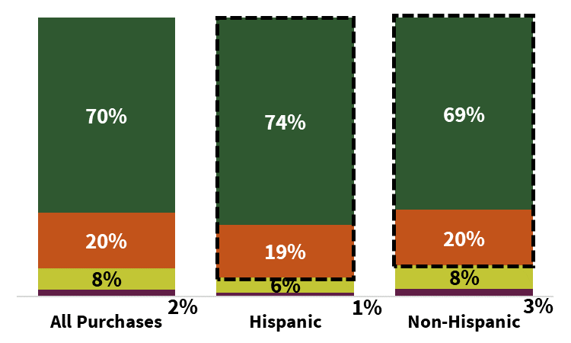
The Super and Heavy segments make up a greater proportion of Hispanic avocado purchases than Non-Hispanic purchases
Avocado Purchase Segmentation (Purchases) (2019)
The Super and Heavy segments combined make up 93% of Hispanic avocado purchases and 89% of Non-Hispanic avocado purchases
The Super segment makes up the largest share of both Hispanic and Non-Hispanic avocado purchases
Source: IRI Consumer NetworkTM 2020 (All figures are rounded)

Slide 39
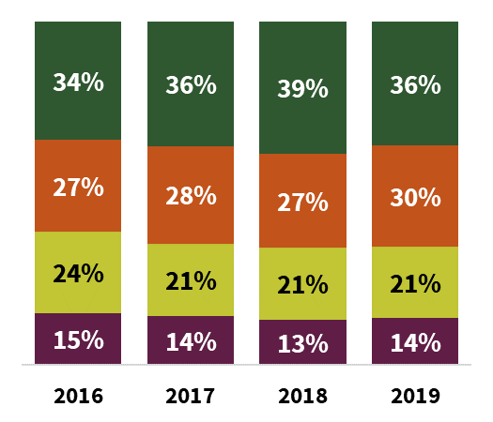
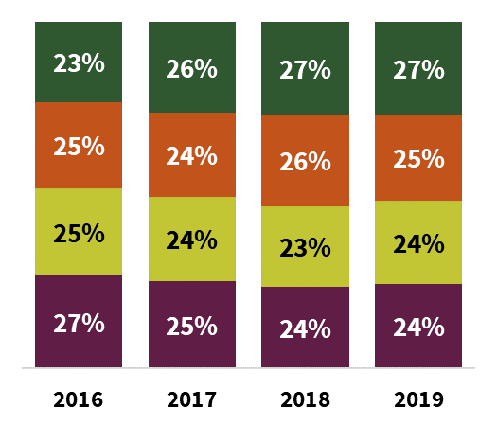
The Super segment is growing among Hispanic and Non-Hispanic household groups
Hispanic Avocado Shopper Segmentation (Households)
Non-Hispanic Avocado Shopper Segmentation (Households)
The proportion of Hispanic Super households increased from 34% in 2016 to 36% in 2019
The Super segment made up the smallest proportion of Non-Hispanic households in 2016 at 23% of households. In 2019, the Super segment made up the largest proportion of households at 27%
Source: IRI Consumer NetworkTM 2020 (All figures are rounded)

Slide 40
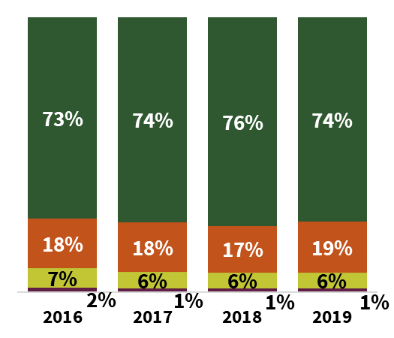
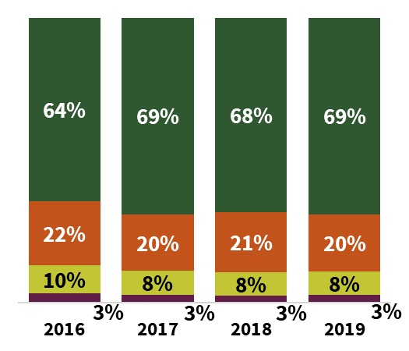
Super segment share of avocado purchases is growing for Hispanic and Non-Hispanic household groups
Hispanic Avocado Shopper Segmentation (Purchases)
Non-Hispanic Avocado Shopper Segmentation (Purchases)
The proportion of Hispanic Super household avocado purchases increased from 73% in 2016 to 74% in 2019
The proportion of Non-Hispanic Super household avocado purchases increased from 64% in 2016 to 69% in 2019
Source: IRI Consumer NetworkTM 2020 (All figures are rounded)

Slide 41
Avocados increased market basket value by +72% in 2019
Market Basket Value
Without Avocados vs. With Avocados
Hispanic household market basket premium with avocados has declined -8.8% since 2016, while the Non-Hispanic market basket premium has increased +1.1%
Indicates highest annual Market
Basket Increase for each group
Source: IRI Consumer NetworkTM 2020 (All figures are rounded)

Slide 42
Rest-of-basket value* also increases when avocados are included
Rest of Market Basket Value
Without Avocados vs. With Avocados
Hispanic household rest-of-basket premium declined -8.9% since 2016, while the Non-Hispanic market basket premium increased +0.8%
+65.0%
premium!
Indicates highest annual Rest of
Market Basket Increase for each group
Source: IRI Consumer NetworkTM 2020 (All figures are rounded) *Rest-of-basket value = the value of all other non-avocado items in the basket

Slide 43
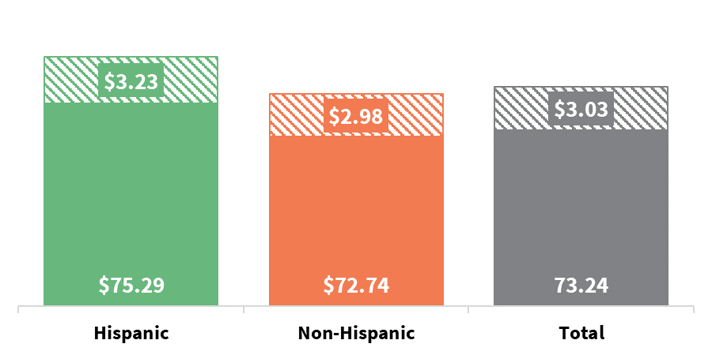
Hispanic households yield a higher market basket spend and avocado spend
Market Basket Value (2019)
$75.29
$72.74
$73.24
Avocado Dollars
Indicates highest annual Market
Basket avocado share for each group
Hispanics spend $75.29 on total basket, +3.5% more than Non-Hispanic households ($72.74)
Avocados make up a larger proportion of Hispanic household markets baskets then Non-Hispanic market baskets
2019 Avocado Share of Basket:
  Hispanic: 4.3%
  Non-Hispanic: 4.1%
Source: IRI Consumer NetworkTM 2020 (All figures are rounded)

Slide 44




Data Source: IRI Consumer NetworkTM
This report is based on household purchasing data from the IRI Consumer NetworkTM. IRI receives its household purchasing data from the National Consumer Panel (NCP), an operational joint venture by IRI and Nielsen. The NCP is a continuous household purchasing consumer panel that consists of a representative sample of U.S. households who electronically record all purchases. Households are recruited to the NCP and are incented to record all of their purchases, regardless of where purchased, using a handheld in-home scanning device.
Household purchasing data complements retail sales data and provides a deeper understanding of category dynamics by focusing on shoppers and their purchase behaviors. In turn, understanding shopper purchase behaviors helps uncover opportunities for growth and aids in effective sales and marketing decisions.
In-store purchases
Electronically recorded at home

Slide 45
Terms and Definitions
Shopper Household Groups
  Total Households
  Hispanic Households
  Non-Hispanic Households
Shopper Segmentation:
  By Purchase Level (Super, Heavy, Medium, Light) – See page 8 for methodology and definitions
Metrics: All figures in this report are rounded
  Household Penetration – Percentage of total U.S. households that purchase the category
  Buyer Rate (Annual Spend per Category-Buying Household) – Average annual spend on the category per category-buying household. Annual Spend = Number of Trips X Spend per Trip
  Number of Trips – Average annual category purchase occasions per category-buying household
  Purchases – Throughout this report, “Purchases” refers to dollar purchases. Volume/units/eaches are not available
  Market Basket Value – Average dollar ring per shopping trip. Calculated with and without avocados
  In-Basket Premium – Incremental value of the Market Basket when avocados are in the basket
  Rest-of-Basket Value – Average value of the other (non-avocado) items in the basket when avocados are in the basket
  Rest-of-Basket Premium – Incremental value of other items in the basket when avocados are in the basket
Time Periods:
  Calendar Year 2019, 2018, 2017, 2016
Source Data:
  IRI Consumer NetworkTM 2020 (Details on page 44)
  FUSION: Study development
Exemption clause: The opinions expressed in the present document are solely those of the authors, and under no circumstances may be considered as stating the HAB's official position. The contents were drawn up in all good faith. However, the authors cannot guarantee the exhaustiveness or accuracy of the information provided, nor that this information is up to date or appropriate for specific purposes.

Slide 46

Thank you
For additional retail information and insights please visit the Hass Avocado Board website at:
hassavocadoboard.com

